Slide 1
Grammar Cat
An Interactive web application for identifying parts of speech.
November 13, 2018
Presented By: Hrishikesh Gadkari

Slide 2
Background
Dr. Anne M.P. Michalek, assistant professor in the communication disorders and special education department in the College of Education along with her student Courtney Johnson developed the idea for Grammar Cat.
Came to ITS with a board game and wanted to make it an app.

Slide 3


Introduction
The aim of this project is to provide an Interactive application for identifying parts of speech.
Developed for Undergraduate students, It’s a self-paced, self-assessing practice exercise, and engaging application activity whereby students may work independently.
What is “grammar”????

Slide 4
Grammar Cat Functionality
Drag and drop
Drag and drop functionality is used to achieve the appropriate answer.
Parts of Speech
Grammar Cat covers following topics in details to ensure a solid foundation is built.
Subjective Pronoun, Objective Pronoun, Possessive Pronoun, Main Verb, Auxiliary Verb, Secondary Verb, Preposition, Conjunction.
Cueing hierarchy for wrong responses.
To keep user motivating and engaging clue’s are provided.
For E.g. Ooopps!! Please try again. Remember: this part of speech replaces a person or object.
Good try. Please try again. Remember: try using the “HE” rule
Looks like you could use some help: this is a pronoun – it is subjective because
it serves as the subject of the verb.

Slide 5
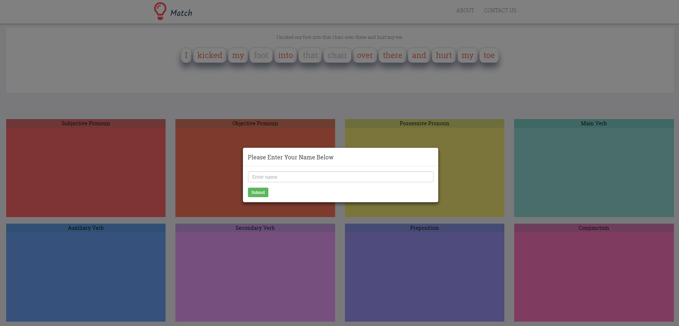
Screenshot/Demo
Welcome Screen : To begin provide the name.

Slide 6
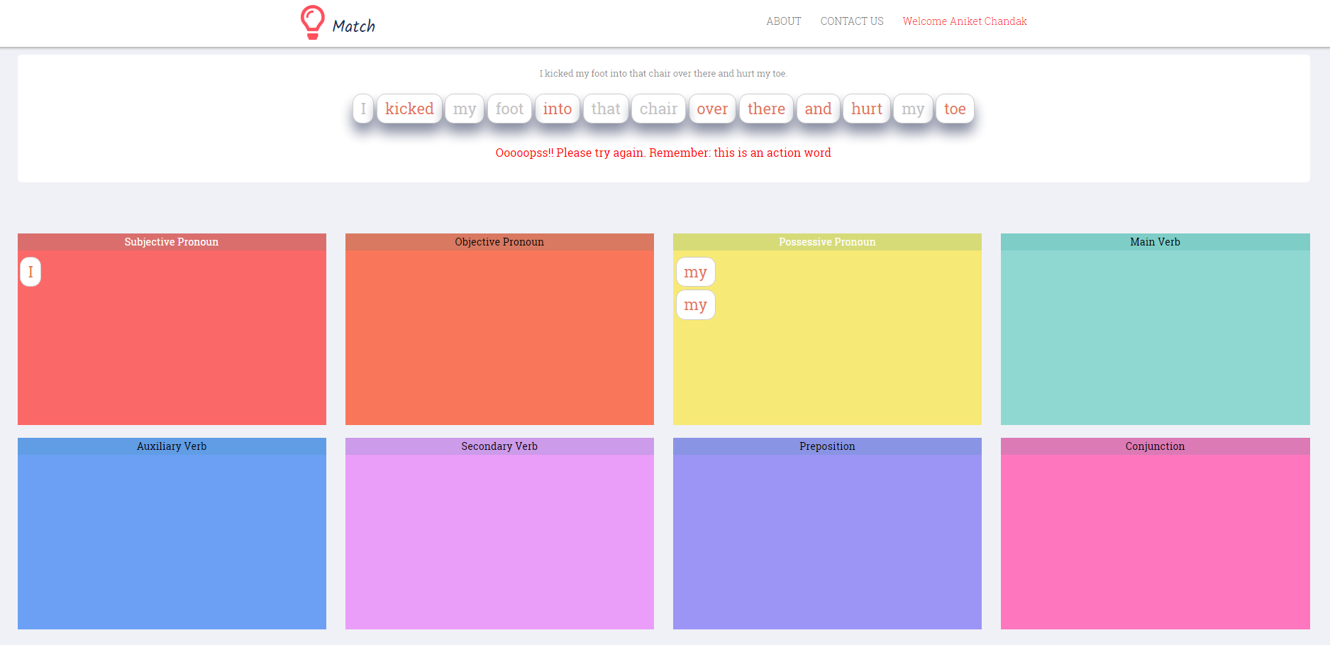
Screenshot/Demo
Negative feedback

Slide 7
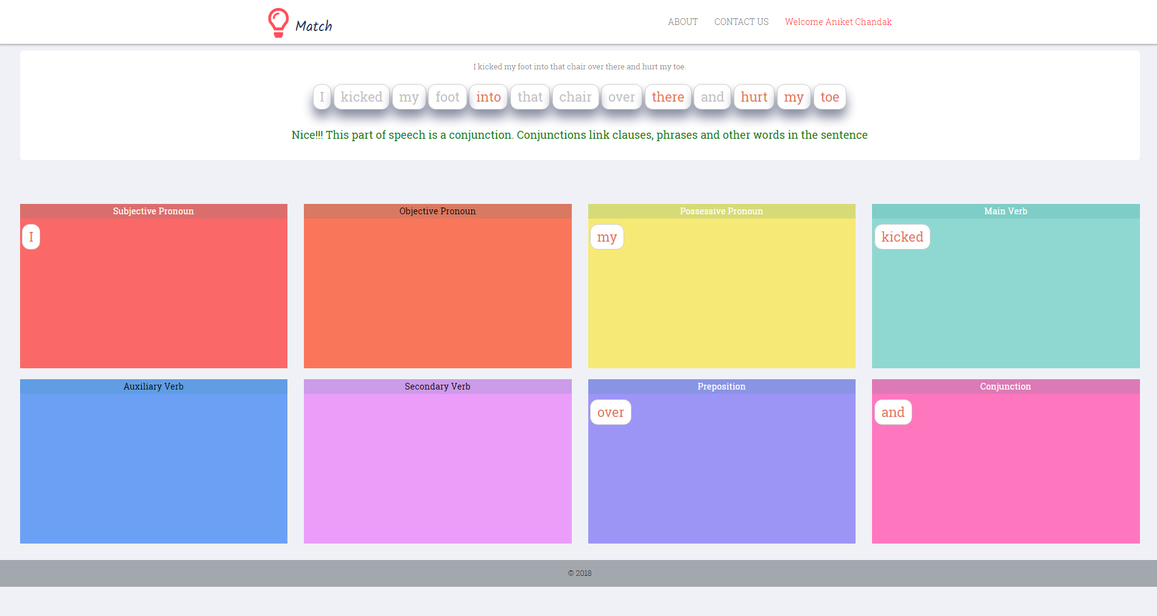
Screenshot/Demo

Slide 8
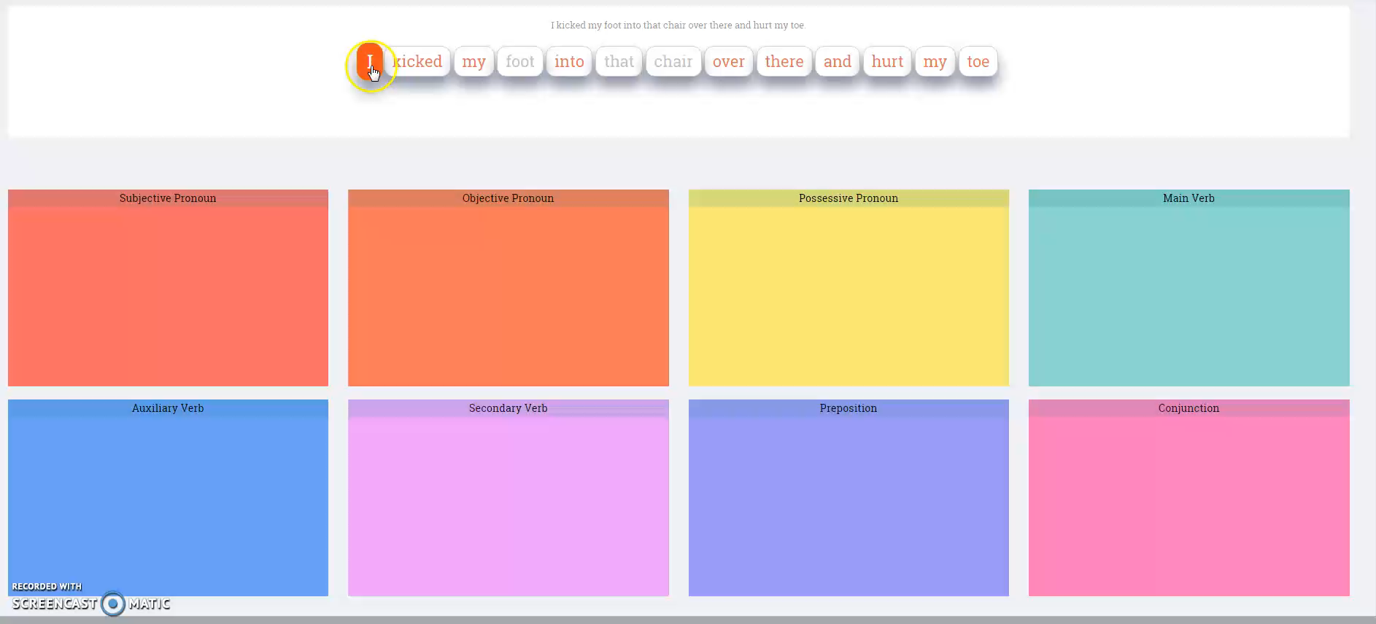

Slide 9

Technology used
To develop grammar cat JQuery, CSS, PHP has been used at front-end.
JQuery is used for implementing Drag ’n’ Drop functionality.
PHP for bridging the gap between front-end and database.
HTML/CSS is used for designing web-page.

Slide 10

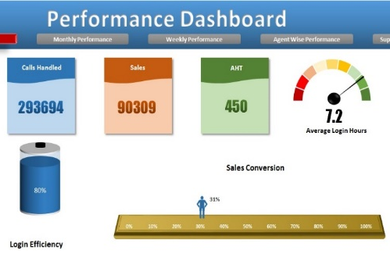

Future Scope
Make this application to have a gaming aspect.
viz. Ranking, Streak, Challenging friends.
Provide Portals.
Dashboard to keep track of all the activity and provide reports.
Provide Visual explanation.
Video/pictorial learning help student to learn concept rapidly.

Slide 11
Any Questions?

